Slide 1

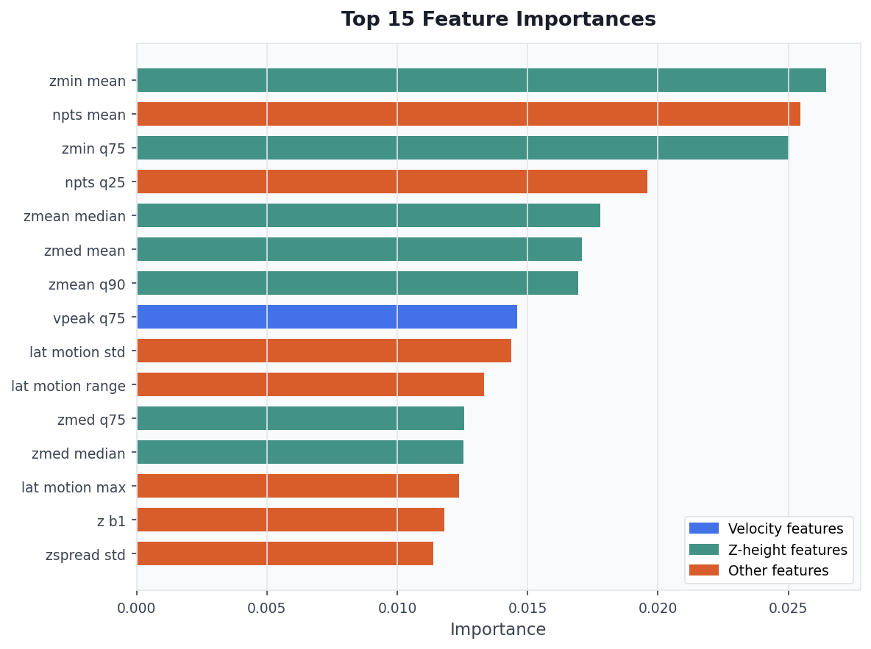
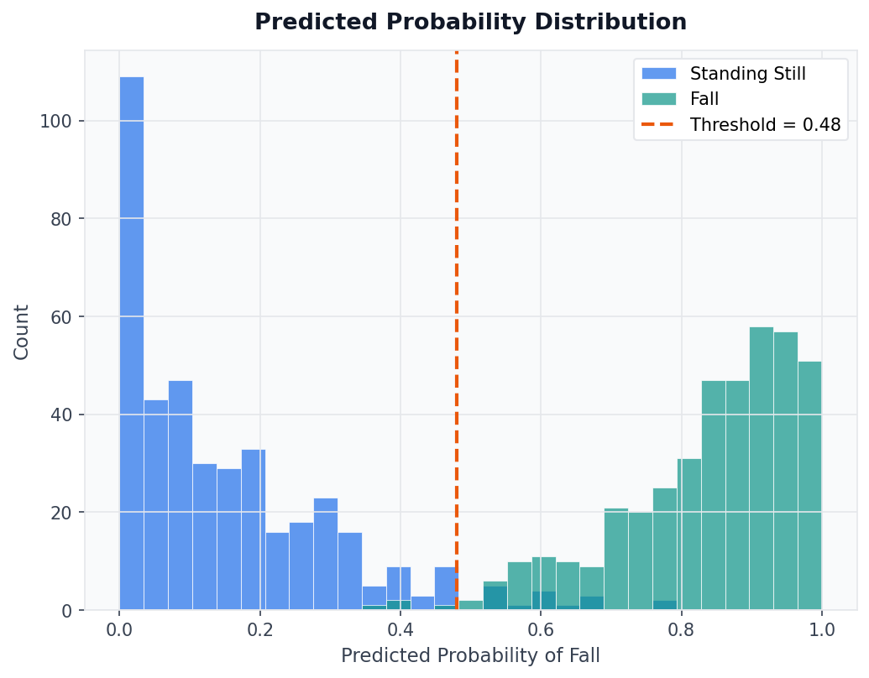
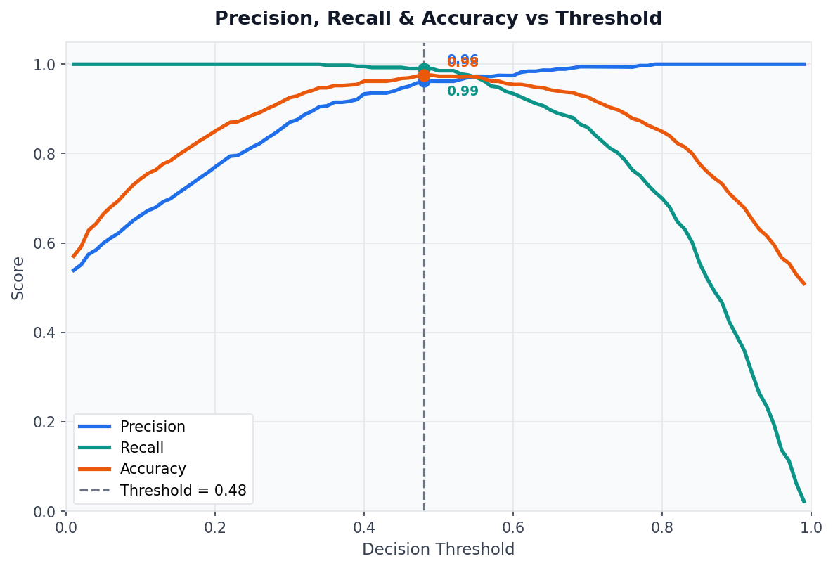
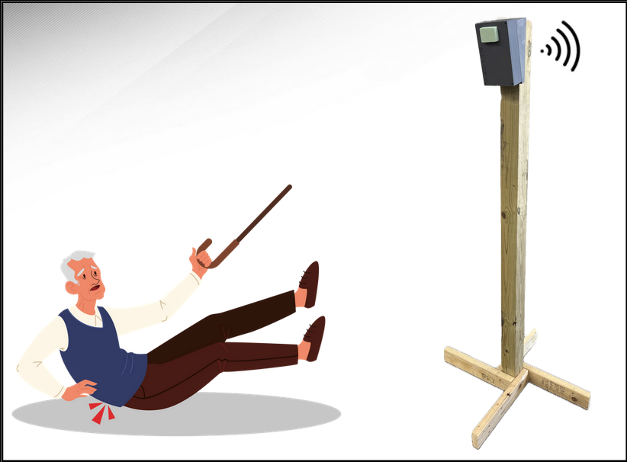

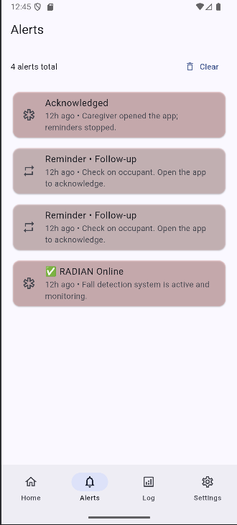
The RADIAN System
Matthew Blackwell, Mitchell Hoffman, & Wyatt Johnson
Dr. Ayra Menon
Problem Definition
Falls are the leading cause of injury in elderly individuals. Many current COTS systems are invasive, such as a camera, or require user input, such as a life-alert press or donning a smart device. RADIAN attempts to solve these challenges through a radar-based system and a machine learning model.
Engineering Analysis
Model Performance:
Through meticulous training, testing, retraining, and validation, the RADIAN team was able to create a model that had:
Precision at 0.96, Recall at 0.99, and Accuracy at 0.98 at a threshold of 0.48
FIGURE HERE
Design
The RADIAN system is broken up into 3 separate systems to solve the challenges present with current fall detection solutions. The RADIAN system will automatically detect falls in real time with minimal user input, preserve privacy, and send an immediate and accurate notification alert to caregivers.
Physical
Power distribution and charging
Enclosure and stand
System Pipeline
Data
Machine Learning model (ExpertTrees)
Sending notification to Gotify Server
System Pipeline
Wireless
Radar configuration and parsing
Setting up Gotify Server
RADIAN Application on personal device
Figure 4. Fall vs. Non-Fall Probability Distribution
Figure 3. Graph of Top 15 Feature Importances
The RADIAN system is a student-designed non-invasive, privacy-preserving solution that eliminates the need for cameras or wearable devices.
Outcomes
Achieved real-time fall detection, with a real-world fall accuracy of ~75% and an alert rate of 100% within 1 second at any range.
Impact
The RADIAN system provides peace of mind for elderly individuals and their families by ensuring rapid response in the event of a fall. Through this design, the RADIAN team
Provides a scalable solution that can be deployed in homes, assisted living facilities, and hospitals
Reduces response time to falls, allowing the caregivers to be notified immediately and potentially preventing serious injury
Demonstrates the viability of the combination of radar-based sensing and machine learning for real-world healthcare applications
1
mmWave Radar
TI AWR6843ISK
Figure 2. Graph of Precision, Accuracy, and Recall
UART Parser
Point cloud decode and Clustering
Threshold Tradeoff:
The RADIAN team found that a threshold of 0.90 led to fewer false positives, but struggled to detect falls overall. They found that a threshold of 0.48 led to better fall detection, but many more false positives, leading to the chosen 0.70 threshold.
2
3
Feature Extraction
289 features including z-drop and v-spike
4
ML Inference
ExtraTrees, Sliding Window, and 32 FPS
Key Features:
Z-height features were the strongest predictors in the RADIAN ML model, where falls are characterized by a rapid decrease in vertical body position. Point density is also heavily considered, where the number of points changes during a fall, indicating body compression and posture change. Velocity features were less dominant, showing that the model learned that motion alone does not constitute a fall. Overall, the model relies more on spatial posture changes than on motion alone, aligning with the physical characteristics of a fall.
5
Alert System
GPIO Buzzer, Gotify push notifications, CSV Logging
Figure 4. System-level Pipeline Diagram
Implemented real-time detection pipeline, processing radar data and triggering alerts with minimal latency
Developed a fully functional radar-based fall detection system integrating sensing, machine learning, and wireless communication
Successfully differentiated falls from normal activities such as walking, sitting and standing using spatial and statistical features.
References
TI AWR6843ISK mmWave Sensor Datasheet, Texas Instruments, 2021
Pedregosa et al., "Scikit-learn: Machine Learning in Python," JMLR, 2011
Gotify Server Documentation, gotify.net
TI mmWave SDK User Guide, Texas Instruments, 2021
Raspberry Pi 3 Model B+ Specifications, Raspberry Pi Foundation
Acknowledgements
The RADIAN team would like to thank Dr. Ayra Menon, Roman Venagas, and Manoj Kumar Balamurugan for their guidance throughout this project, as well as the Texas A&M Department of Electrical and Computer Engineering for providing lab resources and support.
Figure 1. Full System Diagram

